Slide 1
HTML Basics
1. HTML means Hyper Text Markup Language. HTML is the language of the Internet used to create Web pages of web sites.
2. HTML is a set of tags or commands used to create HTML document.
3. HTML file display images, text, différent font etc.
4. HTML has same features of a basic word processing program and it is capable of using graphics.
5. HTML is used to design various homepages and hypertext documents of web pages.
6. HTML document allows information to be presented in a multimedia format with hyperlinks.
7. Hyperlink is used to link between pages.

Slide 2
STRUCTURE OF HTML DOCUMENT:
1. HTML files are normal text files, usually have the extension of .htm or .html.
2. HTML is not a case sensitive language.
3. HTML instructions divide the text of a document into blocks called elements.
4. An HTML document has two parts.
a. Head part
b. Body part

Slide 3
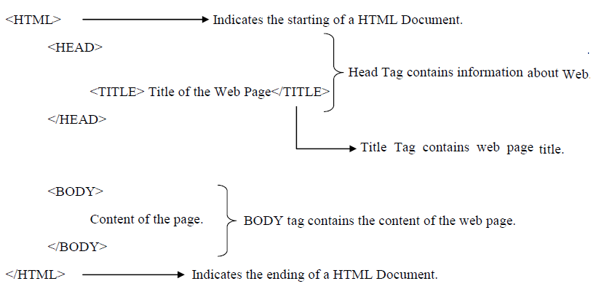

Slide 4
HEAD: The head element contains title and meta data of a web document. BODY: The body element contains the information that display on a web page. 1. The first tag is <html>. This tag tells your browser that this is the start of an HTML document. The last tag is </html>. This tag tells your browser that this is the end of the HTML document. 2. The text between the <head> tag and </head> tag is header information. Header information is not displayed in the browser window. 3. The text between the <title> tag and </title> tag is the title of your document. The title is displayed in your browser’s title bar. 4. The text between the <body> tag and </body> is the text that will be displayed in your browser.

Slide 5
TYPES OF TAGS: There are two types of tags in HTML. They are 1. Paired Tag: A Tag which has both opening and closing tag is called as Paired Tag. Example: <b>Welcome</b> 2. Un-Paired Tag: A Tag which doesn’t have its companion tag is called as Un-Paired Tag. Example: <br>, <hr>

Slide 6
HTML Headings HTML supports 6 levels of heading tags. <h1> - Level 1 heading <h2> - Level 2 heading <h3> - Level 3 heading <h4> - Level 4 heading <h5> - Level 5 heading <h6> - Level 6 heading

Slide 7
Example: <HTML> <HEAD> <TITLE> Heading Tags </TITLE> </HEAD> <BODY> <H1> Level 1 Heading</H1> <H2> Level 2 Heading</H2> <H3> Level 3 Heading</H3> <H4> Level 4 Heading</H4> <H5> Level 5 Heading</H5> <H6> Level 6 Heading</H6> </BODY> </HTML>

Slide 8
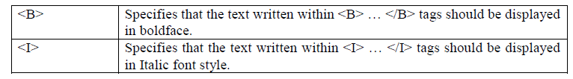
TEXT FORMATTING TAGS:
Text formatting elements are used to change the actual presentation styles of text to make the text bold, italic, underlined etc.
These elements are used to format texts of a page and present them effectively on the user’s screen. All browsers support these elements.
The following are the important text formatting tags.

Slide 9
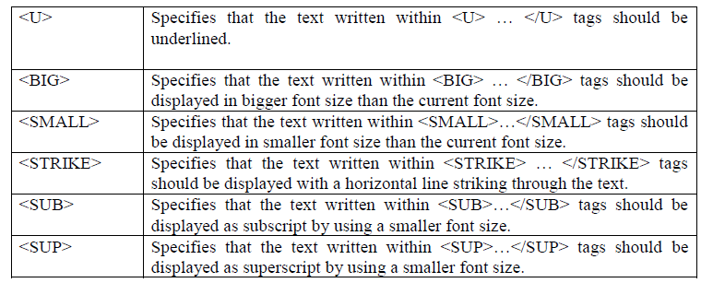

Slide 10
Example: <HTML> <HEAD> <TITLE>Text Formatting Tags</TITLE> </HEAD> <BODY> <B>Using Bold Tag</B><BR> <I>Using Italic Tag </I><BR> <U>Using Underline Tag</U><BR> <BIG>Using Big Tag</BIG><BR> <SMALL>Using Small Tag </SMALL><BR> <STRIKE>Using STRIKE Tag</STRIKE><BR> Using of Subscript Tag : X<SUB>1</SUB> , X<SUB>2</SUB><BR> Using of Superscript Tag : X<SUP>2</SUB> , Y<SUP>3</SUB><BR> </BODY> </HTML>

Slide 11
FONT TAG: The <font> tag alone doesn’t provide any real functionality, but with the help of a few attributes this tag is used to change the style, face, size and color of HTML text elements. Attributes of font Tag: 1. Size: Changes the size of text. The value must be between 1 and 7. 2. Color: Changes the color of the text. 3. Face: Changes the font type of the text. Syntax: <FONT SIZE=value COLOR=color FACE=”font-names”>

Slide 12
Example: <HTML> <HEAD> <TITLE>Text Formatting Tags</TITLE> </HEAD> <BODY> <FONT SIZE=30 FACE=”Times new Roman” COLOR=red> Hello World</FONT> </BODY> </HTML>

Slide 13
IMAGE TAG: 1. Images are inserted in web documents using the IMG tag and this tag has no closing tag. 2. The <IMG> tag requires the location of the image file. 3. <IMG> tag alone doesn’t place an image in the HTML document. It requires another attributes SRC, HEIGHT and WIDTH. Syntax: <IMG SRC=”URL/Path of the image file” WIDTH=value HEIGHT=value>

Slide 14
Example: <HTML> <HEAD> <TITLE> Image Tags</TITLE> </HEAD> <BODY> <img src="one.jpg" width="104" height="142"> </BODY> </HTML>

Slide 15
ANCHOR TAGS OR LINK TAG: 1. HTML allows linking to other HTML documents as well as images. 2. Hyperlinks appear blue in color by default. 3. When the mouse cursor is placed over it, the standard arrow shaped mouse cursor changes to the shape of a hand. LINK – changes the default color of a hyperlink to whatever color is specified with this tag. ALINK – changes the default color of a hyperlink that is activated to whatever color is specified with this tag. VLINK – changes the default color of a hyperlink that is already visited to whatever color is specified with this tag. Syntax: <A HREF=”target file name”> Clickable Text </A>

Slide 16
Example:- <HTML> <HEAD> <TITLE> Hyper links </TITLE> </HEAD> <BODY> <A HREF=https://www.google.com>Click here for Google</A> </BODY> </HTML>

